Slide 1
PROJECT PROPOSAL
MP2 PRESENTATION

Slide 2
INTRODUCTION
In today's proposal, I am excited to present a Student Dashboard System designed to simplify administration tasks and enhance student management

Slide 3
PROJECT OBJECTIVES
My project includes a secure registration and login system, an informative dashboard displaying student counts, a student registration page with automatic ID generation, and a profile page for admin management.

Slide 4
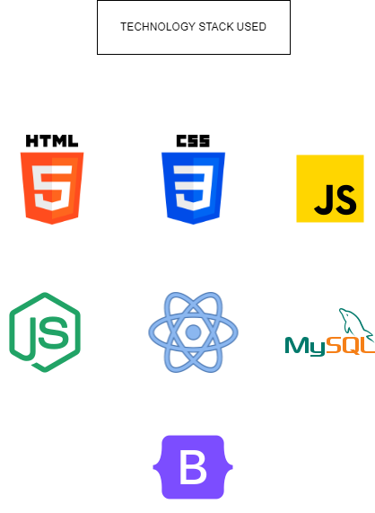

Slide 5
TARGET USERS
Administrators and Staff: Our primary target users are administrators and staff responsible for student management in educational institutions.
System Administrators: System administrators overseeing the technical aspects of the Student Dashboard System.

Slide 6
PROBLEM
Currently, student management processes are prone to inefficiencies and manual errors.
Challenges in tracking and organizing student data can lead to delays and inaccuracies in administration tasks.

Slide 7
SOLUTION
Student Dashboard System aims to address these challenges by providing a comprehensive, automated solution for student registration, data management, and administration

Slide 8
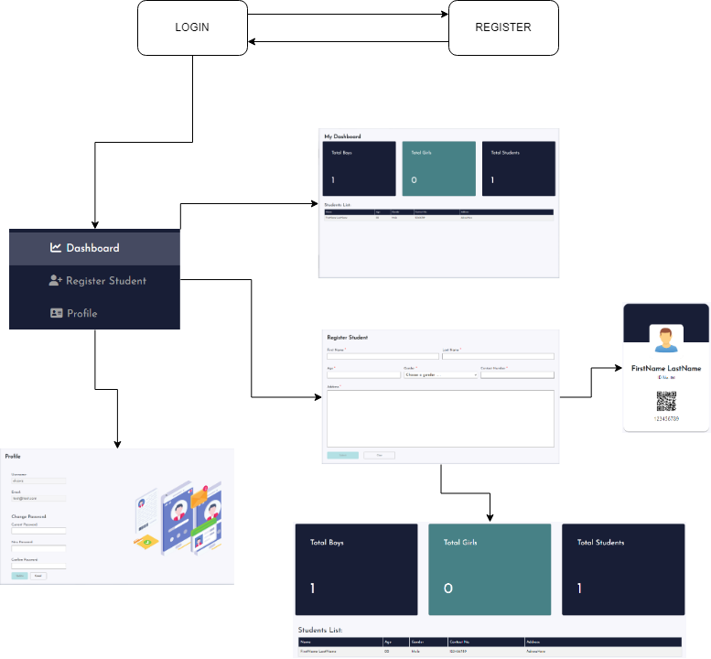

Slide 9
THANK YOU!!
RENZ SAYAMAN – WD89P

